Slide 1

Ergonomics Semester 2 Week 6

Slide 2
What had been discussed last week
Design the algorithm to handle moment of inertia, angular acceleration, and linear acceleration
Keep looking for available dataset with 3D ground truth and video data

Slide 3
Timeline
Content | Date | Progress
Learning Basics of Deep Learning | Sep 2022 | Done
Installing Alphapose/Openpose/VideoPose3D | Sep-Oct 2022 | Done
Learning Ergonomics Basics | Oct-Nov 2022 | Done
Forming a Framework of Time Continuous Cumulative Fatigue
Preparing for Final Exam | Nov-Dec 2022 | Done
Review the Time Continuous Cumulative Fatigue Framework | Dec 2022 | Done
Trying to Extract Coordinates Using Alphapose/Openpose | Dec 2022
Adding on a Cumulative Fatigue Assessment using Alphapose/Openpose with Python | Jan-Mar 2023
Writing a Technical Report for our Research | April 2023

Slide 4




















How to Obtain Acceleration
Linear Kinematics Quantities
Upper Torso
2
y’’
0
1
2
3
x’’
y’’’
B
dt =
1
y’’’’
3
Angular Kinematics Quantities
fps
y’
4
x’’’
C
D
x’’’’
(Magnitude)
x’
A
(Direction)
y
1
x
O

Slide 5
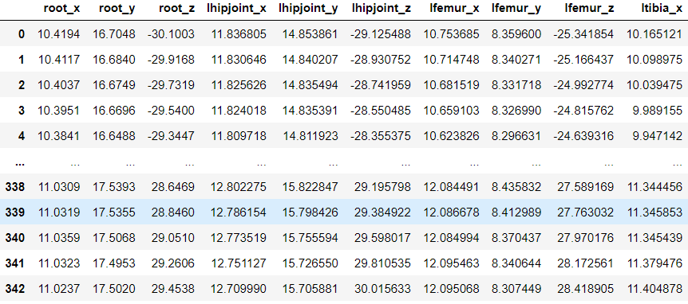
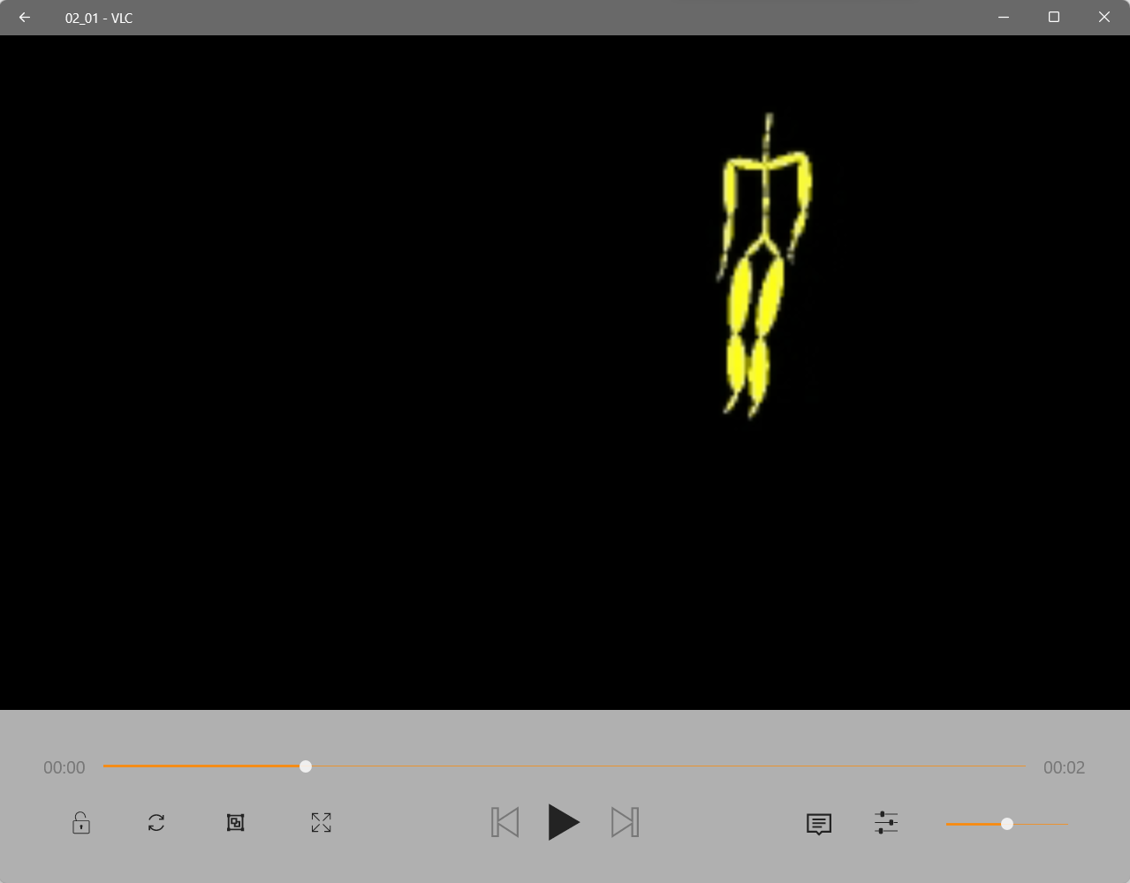
Dataset
https://www.kaggle.com/code/kmader/mocap-with-asf-amc

Slide 6
Challenges of This Week
Found a dataset but not sure why the video file is not a real person, still looking into the details.
Found a way to deal with linear acceleration and angular acceleration but a bit tedious
Remove the noise when doing real time estimation
Moment can consider by repetition same as the continuous assessment

Slide 7
Next Meeting
Design the algorithm to handle angular acceleration and linear acceleration

